Slide 1
SIMULATED ANNEALING

Slide 2
Simulated Annealing
Proposed by Metropolis et al. (1953)
Cooling process of molten metal is modeled artificially to develop an optimization algorithm

Slide 3
Cooling
Molten metal
(High energy state)
Solid state
(Minimum energy state)

Slide 4
At High cooling rate, molten metal is converted into poly-crystalline state
At Slow cooling rate, a crystalline sate is formed
Method of slow cooling (annealing) of molten metal is followed to reach the lowest level of the energy state
Note: Crystalline state is at a lower energy level compared to the poly-crystalline state

Slide 5
Working principle
Optimization Problem
Minimize y = E(X)
subject to
X^{min} ≤ X ≤ X^{max}
where X = {x_{1,} x_{2,……}x_{n}}^{T}

Slide 6
Steps to be Followed
Step 1:
Assume initial high temperature of molten metal: T_{o} Select an initial solution X₀ at random
Termination criterion: є ( a small number)
Set iteration number: t = 0

Slide 7
Steps continued..
Step 2:
Calculate the temperature of (t+1)^{th} iteration,
T_{t+1}= 0.5T_{t}
Generate a candidate solution for (t+1)^{th} iteration, that is, X_{t+1} at random in the neighborhood of X_{t}

Slide 8
Steps continued..
Step 3:
If the change in energy
ΔE = E (X_{t+1}) - E (X_{t}) < 0,
we accept X_{t+1} as the next solution and set t = t+1,

Slide 9
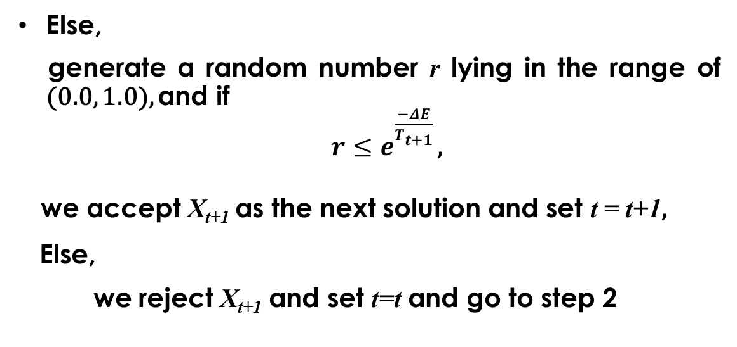
Else,
generate a random number r lying in the range of (0.0, 1.0), and if
$r≤e_{}^{\frac{−ΔE}{T_{t+1}}}$ ,
we accept X_{t+1} as the next solution and set t = t+1,
Else,
we reject X_{t+1} and set t=t and go to step 2

Slide 10
Steps continued..
Step 4:
If │E(X_{t+1}) - E(x_{t}) │< є
and T reaches a small value, we terminate the program.

Slide 11
Boltzman Probability Distribution
A system kept in thermal equilibrium at temperature T has its energy distributed probabilistically as
p(E) = exp^{(-E/KT)},
where K: Boltzman constant

Slide 12
Temp., Probability of energy distributions
No. of iteration, t

Slide 13
At high temperature, the probability of selecting bad solutions is more
At low temperature, the probability of selecting bad solutions is less

Slide 14
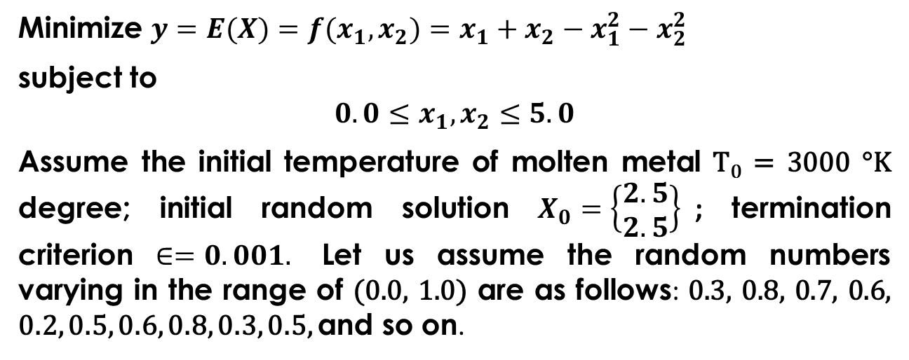
A Numerical Example
Minimize $y=E(X)=f(x_{1},x_{2})=x_{1}+x_{2}−x_{1}^{2}−x_{2}^{2}$
subject to
$$0.0≤x_{1},x_{2}≤5.0$$
Assume the initial temperature of molten metal T₀ = 3000 °K degree; initial random solution $X_{0}=\left\{\begin{matrix}2.5 \\ 2.5\end{matrix}\right\}$; termination criterion $∈=0.001.$ Let us assume the random numbers varying in the range of (0.0, 1.0) are as follows: 0.3, 0.8, 0.7, 0.6, 0.2, 0.5, 0.6, 0.8, 0.3, 0.5, and so on.

Slide 15
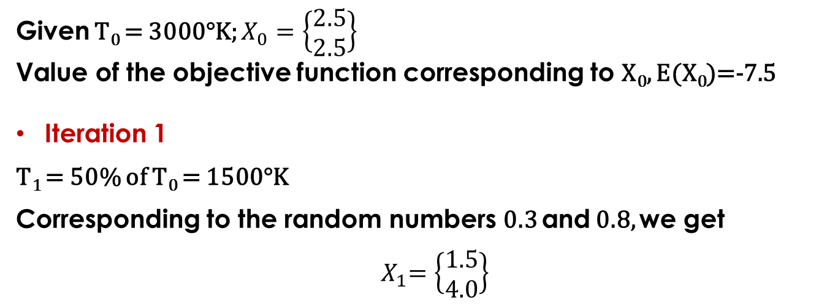
Solution:
Given T₀ = 3000°K; $X_{0}=\left\{\begin{matrix}2.5 \\ 2.5\end{matrix}\right\}$
Value of the objective function corresponding to X₀, E(X₀)=-7.5
Iteration 1
T₁ = 50% of T₀ = 1500°K
Corresponding to the random numbers 0.3 and 0.8, we get
$${ X}_{1}=\left\{\begin{matrix}1.5 \\ 4.0\end{matrix}\right\}$$

Slide 16
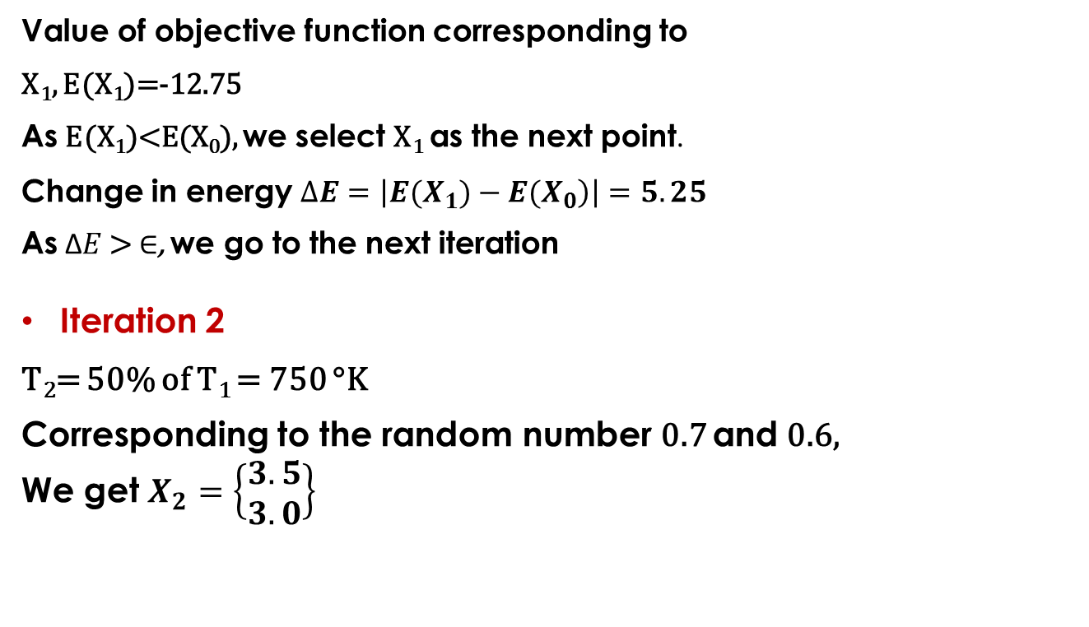
Value of objective function corresponding to
X₁, E(X₁)=-12.75
As E(X₁)<E(X₀), we select X₁ as the next point.
Change in energy $∆E=\left|\left.E(X_{1})−E(X_{0}\right)\right|=5.25$
As Δ$E$ > $∈$, we go to the next iteration
Iteration 2
T₂= 50% of T₁ = 750 °K
Corresponding to the random number 0.7 and 0.6,
We get $X_{2}=\left\{\begin{matrix}3.5 \\ 3.0\end{matrix}\right\}$

Slide 17
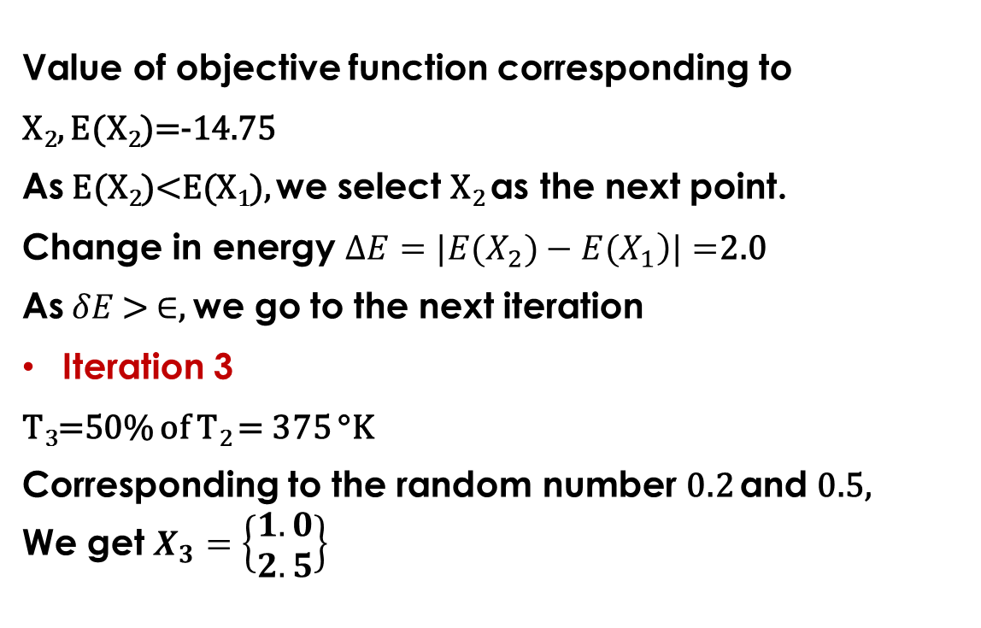
Value of objective function corresponding to
X₂, E(X₂)=-14.75
As E(X₂)<E(X₁), we select X₂ as the next point.
Change in energy $∆E=|\left.E(X_{2})−E(X_{1}\right)|=$2.0
As $δE$ > $∈$, we go to the next iteration
Iteration 3
T₃=50% of T₂ = 375 °K
Corresponding to the random number 0.2 and 0.5,
We get $X_{3}=\left\{\begin{matrix}1.0 \\ 2.5\end{matrix}\right\}$

Slide 18
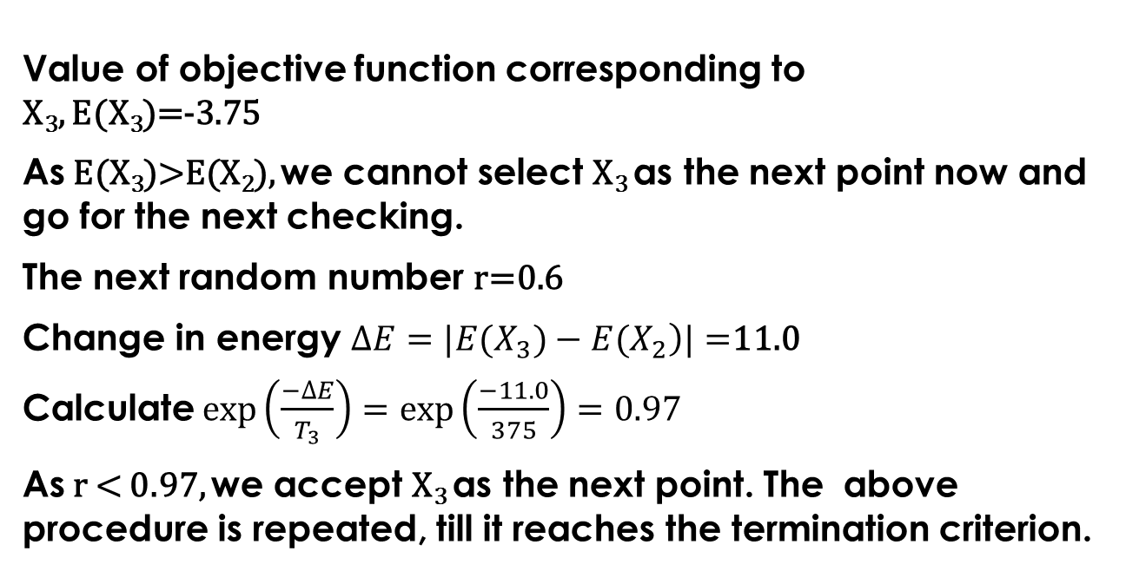
Value of objective function corresponding to
X₃, E(X₃)=-3.75
As E(X₃)>E(X₂), we cannot select X₃ as the next point now and go for the next checking.
The next random number r=0.6
Change in energy $∆E=|\left.E(X_{3})−E(X_{2}\right)|=$11.0
Calculate $exp\left(\frac{−∆E}{T_{3}}\right)=exp\left(\frac{−11.0}{375}\right)=0.97$
As r < 0.97, we accept X₃ as the next point. The above procedure is repeated, till it reaches the termination criterion.

Slide 19
PARTICLE SWARM OPTIMIZATION

Slide 20
Particle Swarm Optimization (PSO)
Proposed by Kennedy and Eberhart, 1995
Population-based evolutionary computation technique
Developed by simulating bird flocking, fish schooling
The algorithm starts with a population (swarm) of random solutions (particles)

Slide 21
The particles have memory and each of them keeps track of its previous (local) best position (P_{best}).
The particle with the greatest fitness is known as the global best P_{g} of the swarm.
Here i^{th} particle in d-dimensional space is denoted by
X_{i} = (x_{i1}, x_{i2},……, x_{id}) and i = 1,2,……….N;
where N = Population size
P_{best} of i^{th} particle is denoted by P_{i} = ( p_{i1}, p_{i2}, ……, p_{id})

Slide 22
Global best P_{g} is represented as P_{g} = ( p_{g1},p_{g2},…………, p_{gd} )
Velocity of i^{th} particle V_{i} = (v_{i1}, v_{i2},……….., v_{id} )

Slide 23
Velocities and positions of i^{th} particle are updated as follows:
provides momentum
$$\left.V_{id}^{\left(t+1\right)}=WV_{id}^{\left(t\right)}+c_{1}r_{1}(p_{id}−X_{id}^{\left(t\right)})+c_{2}r_{2}(p_{gd}−X_{id}^{\left(t\right)}\right)$$
inertia weight
Social component indicating collaborating effect; it pulls the particle towards the globally best particle found so far.
Cognitive component representing personal thinking

Slide 24
x_{id} ^{(t+1)} = x_{id}^{(t)} + v_{id} ^{(t+1)}
where w = constant (inertia weight)
c₁ = cognitive constant (+ve)
c₂ = social constant (+ve)
r₁ and r₂ are random numbers lying in the range of (0.0, 1.0)
t = iteration number
i = 1,2,………,N, where N is the swarm size.

Slide 25
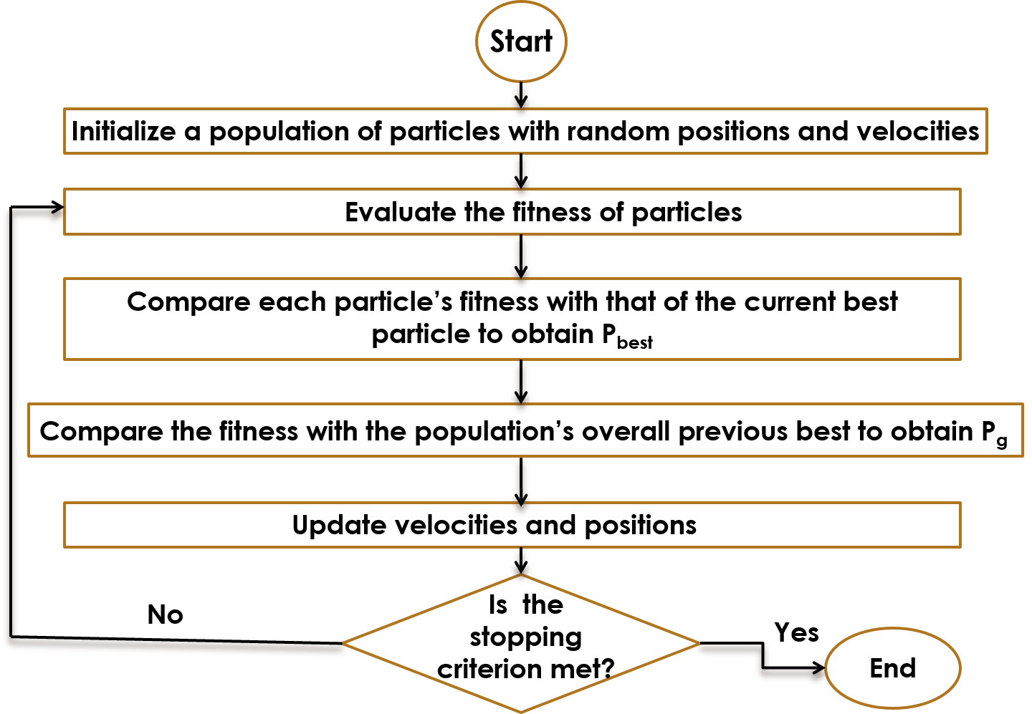
Flowchart
of PSO

Slide 26
COMPARISON BETWEEN PSO & GA
GA
Population-based search
Crossover and mutation are important operators
Solutions do not have memory
Powerful tool for global optimization
Slower
PSO
Population-based search
No operator like crossover or mutation
Particles have memory
Carries out both the global and local searches simultaneously
Faster
NOTE: PSO is expected to provide the better results compared to the GA for
most of the optimization problems

Slide 27
NOTE: PSO is expected to provide the better results compared to the GA for most of the optimization problems

Slide 28
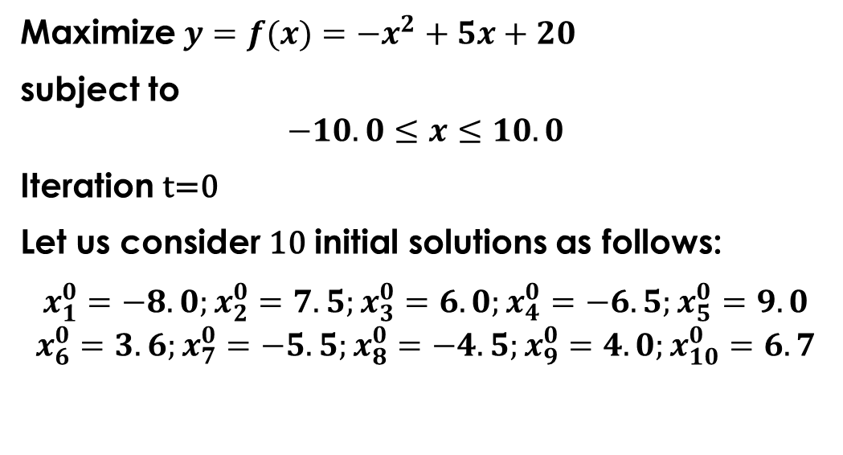
A Numerical Example (PSO)
Maximize $y=f(x)=−x^{2}+5x+20$
subject to
$$−10.0≤x≤10.0$$
Iteration t=0
Let us consider 10 initial solutions as follows:
$$x_{1}^{0}=−8.0;x_{2}^{0}=7.5;x_{3}^{0}=6.0;x_{4}^{0}=−6.5;x_{5}^{0}=9.0$$
$$x_{6}^{0}=3.6;x_{7}^{0}=−5.5;x_{8}^{0}=−4.5;x_{9}^{0}=4.0;x_{10}^{0}=6.7$$

Slide 29
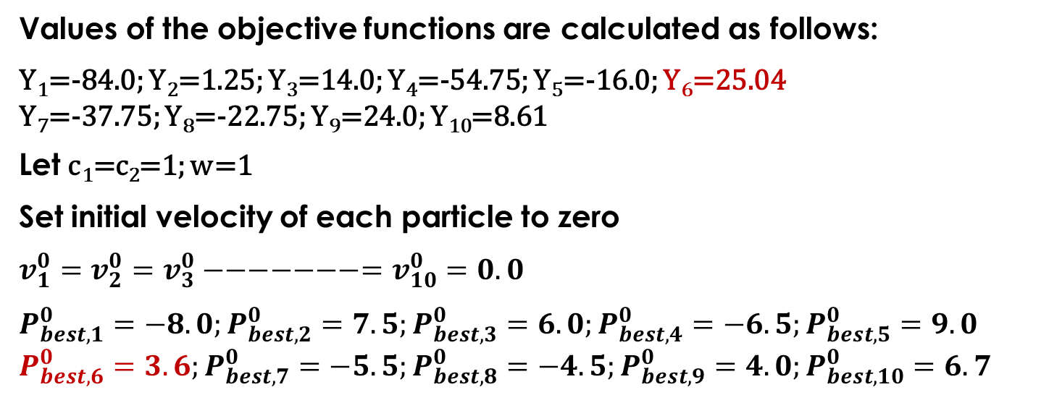
Values of the objective functions are calculated as follows:
Y₁=-84.0; Y₂=1.25; Y₃=14.0; Y₄=-54.75; Y₅=-16.0; Y₆=25.04
Y₇=-37.75; Y₈=-22.75; Y₉=24.0; Y₁₀=8.61
Let c₁=c₂=1; w=1
Set initial velocity of each particle to zero
$$v_{1}^{0}=v_{2}^{0}=v_{3}^{0}−−−−−−−=v_{10}^{0}=0.0$$
$$P_{best,1}^{0}=−8.0;P_{best,2}^{0}=7.5;P_{best,3}^{0}=6.0;P_{best,4}^{0}=−6.5;P_{best,5}^{0}=9.0$$
$$P_{best,6}^{0}=3.6;P_{best,7}^{0}=−5.5;P_{best,8}^{0}=−4.5;P_{best,9}^{0}=4.0;P_{best,10}^{0}=6.7$$

Slide 30
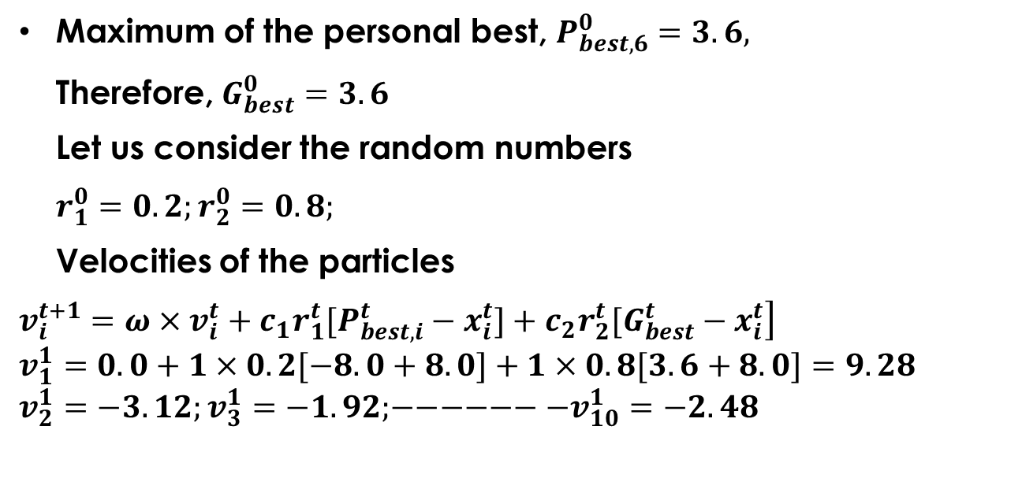
Maximum of the personal best, $P_{best,6}^{0}=3.6,$
Therefore, $G_{best}^{0}=3.6$
Let us consider the random numbers
$r_{1}^{0}=0.2;r_{2}^{0}=0.8;$
Velocities of the particles
$$\left.v_{i}^{t+1}=ω×v_{i}^{t}+c_{1}r_{1}^{t}[P_{best,i}^{t}−x_{i}^{t}]+c_{2}r_{2}^{t}[G_{best}^{t}−x_{i}^{t}\right]$$
$$v_{1}^{1}=0.0+1×0.2[−8.0+8.0]+1×0.8[3.6+8.0]=9.28$$
$$v_{2}^{1}=−3.12;v_{3}^{1}=−1.92;−−−−−−−v_{10}^{1}=−2.48$$

Slide 31
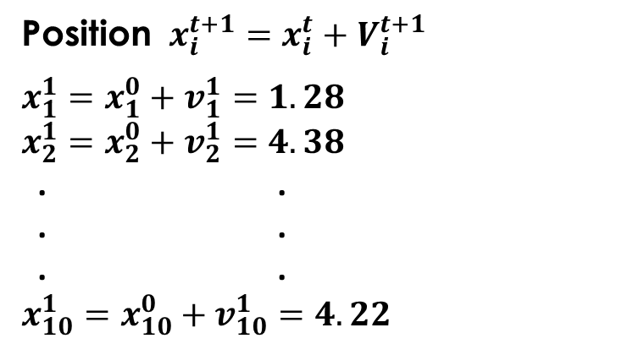
Position $x_{i}^{t+1}=x_{i}^{t}+V_{i}^{t+1}$
$$x_{1}^{1}=x_{1}^{0}+v_{1}^{1}=1.28$$
$$x_{2}^{1}=x_{2}^{0}+v_{2}^{1}=4.38$$
. .
. .
. .
$$x_{10}^{1}=x_{10}^{0}+v_{10}^{1}=4.22$$

